Slide 1


SE2224 FINAL PROJECT
Mert Kahraman
20070006020
Section 1

Slide 2
CONTENTS
Introduction
Login Screen
Deadline
Main Screen
Insert a Task
Update a Task
Filtering and Sorting Tasks
Delete a Task
Image

Slide 3
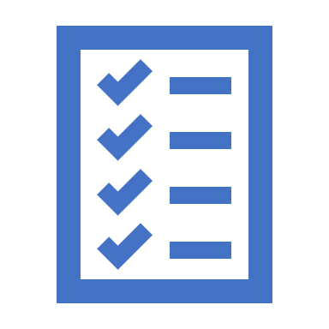
Task Planner, a software program designed to help you efficiently and conveniently organize your responsibilities and activities. Whether you're a busy professional, a student juggling multiple tasks, or someone who simply wants to stay organized, Task Planner is the perfect tool for you.

Slide 4
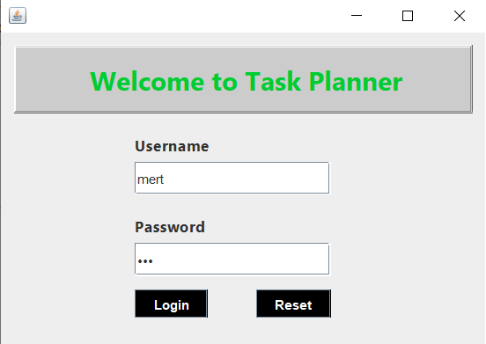
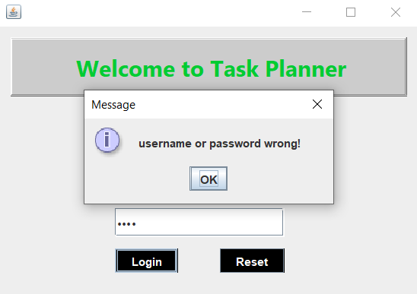
LOGIN SCREEN

Slide 5
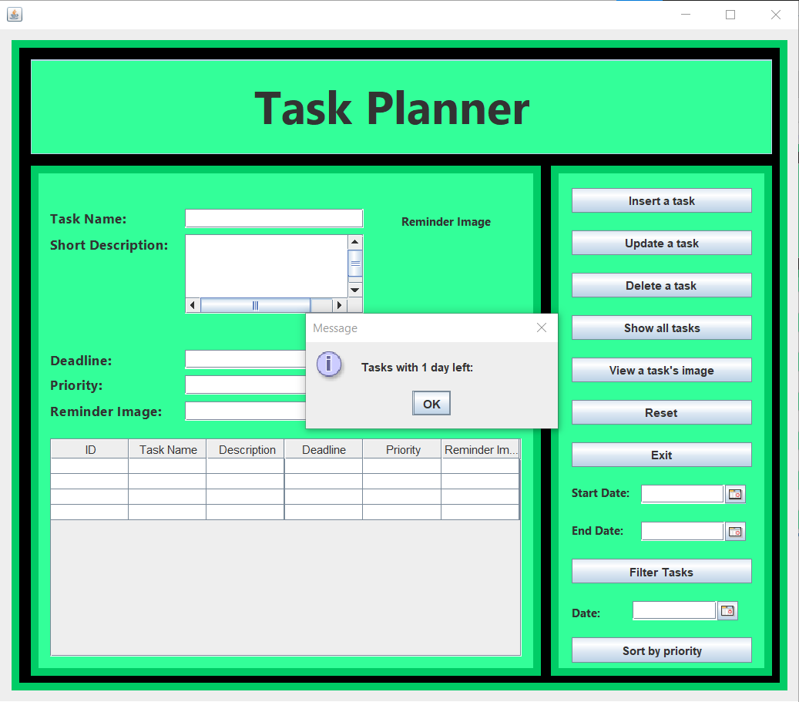
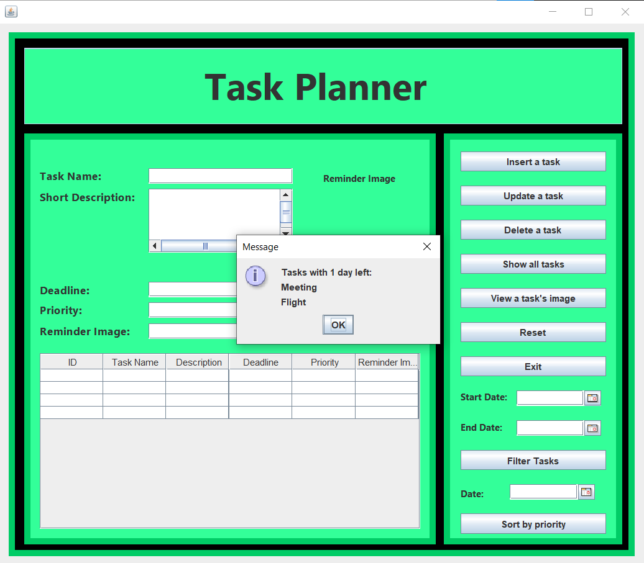
DEADLINE

Slide 6
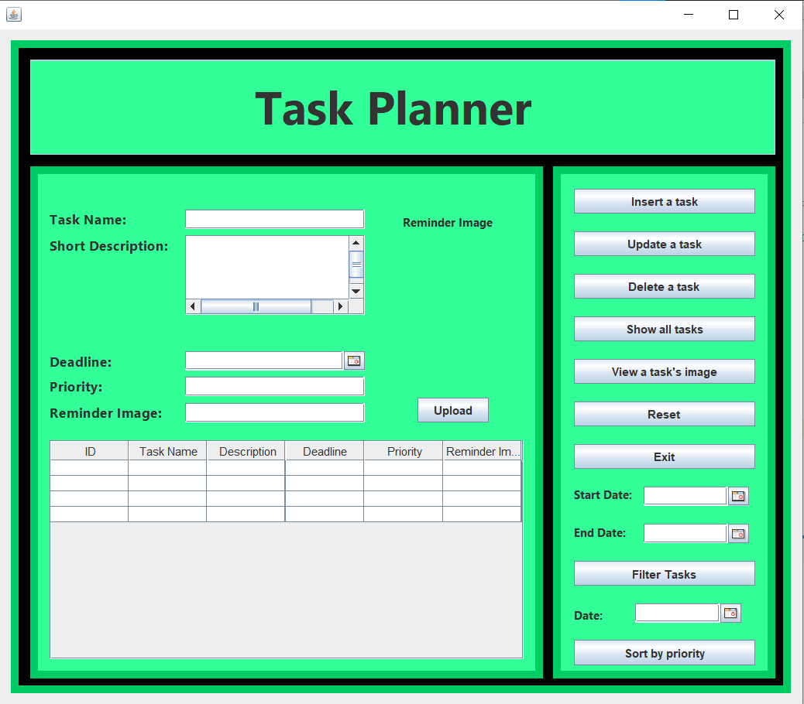
MAIN SCREEN

Slide 7
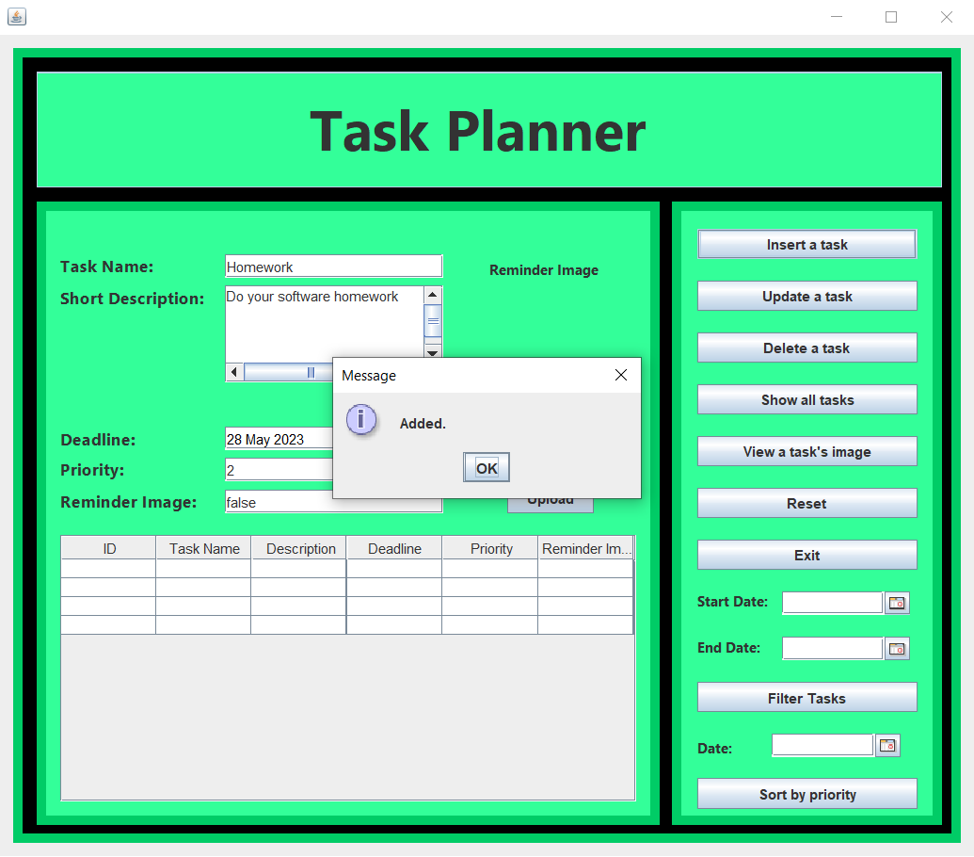
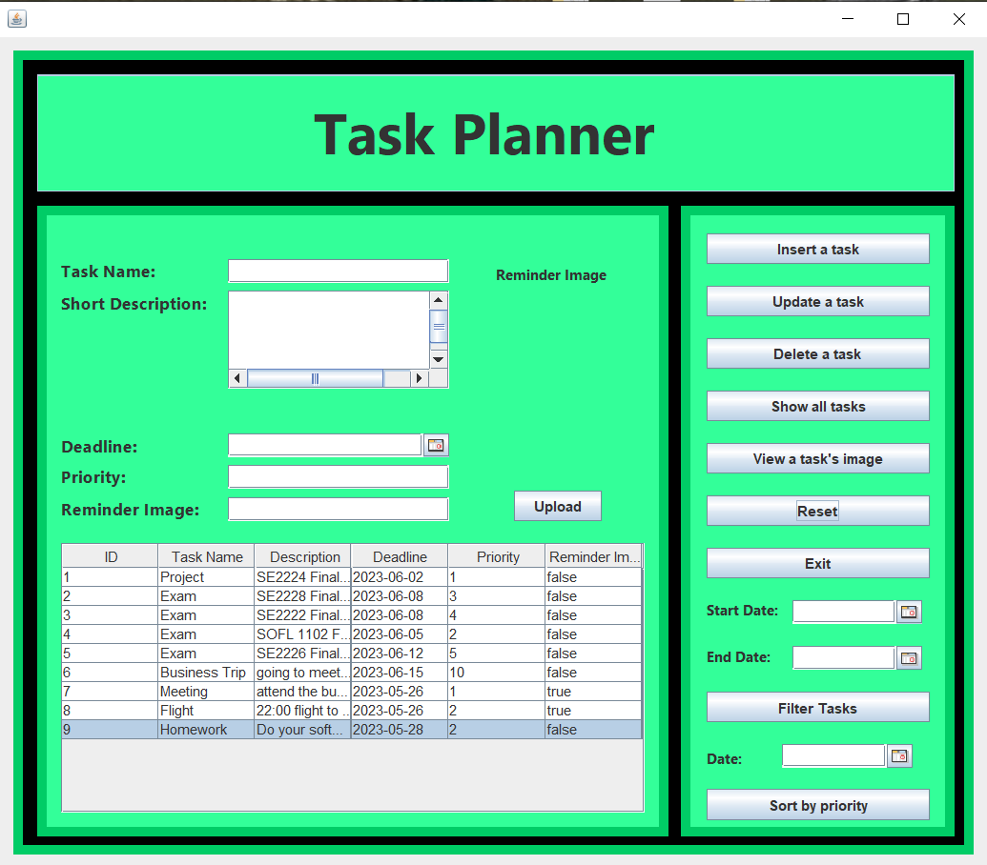
INSERT A TASK

Slide 8
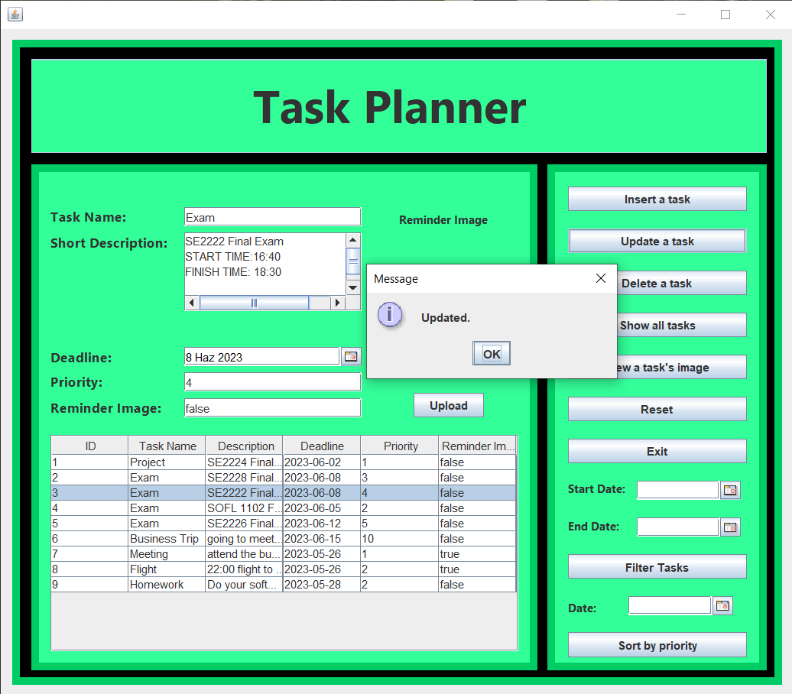
UPDATE A TASK

Slide 9
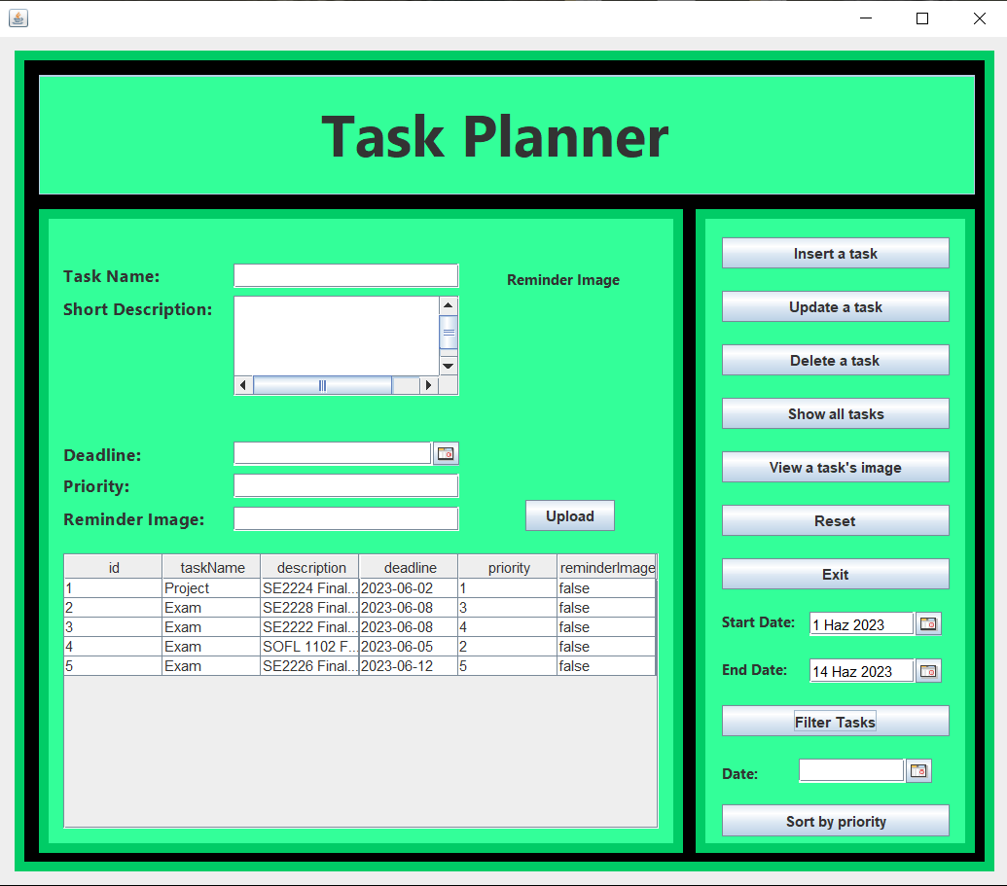
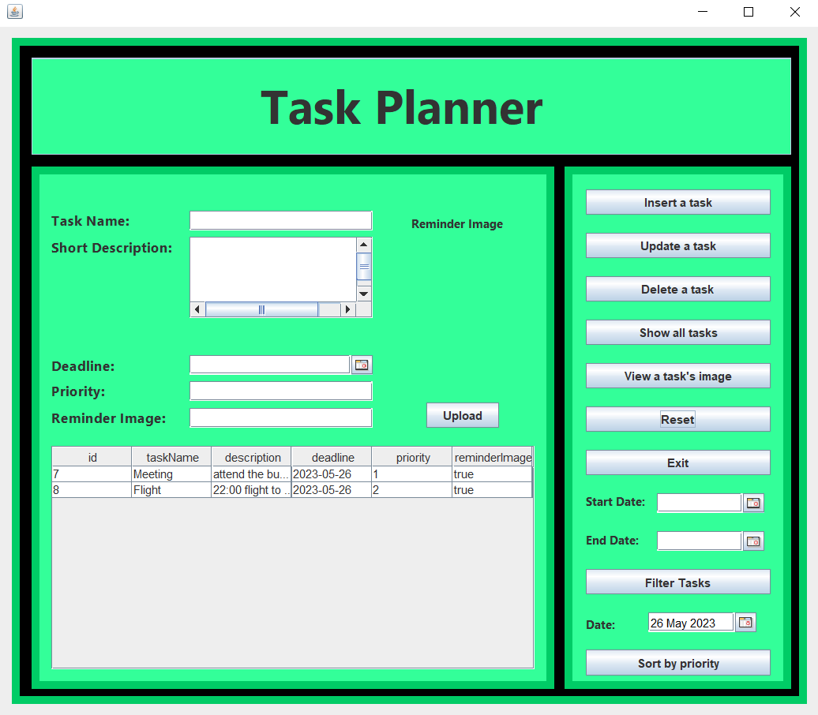
FILTERING AND SORTING TASKS

Slide 10
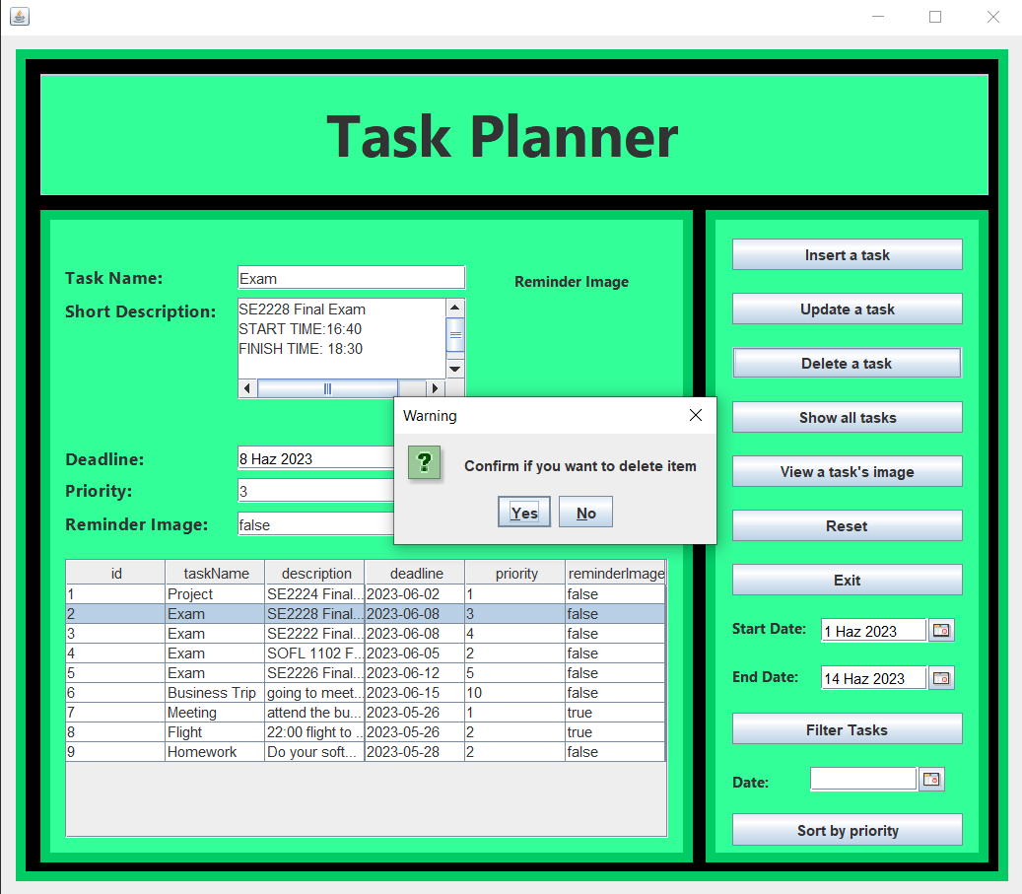
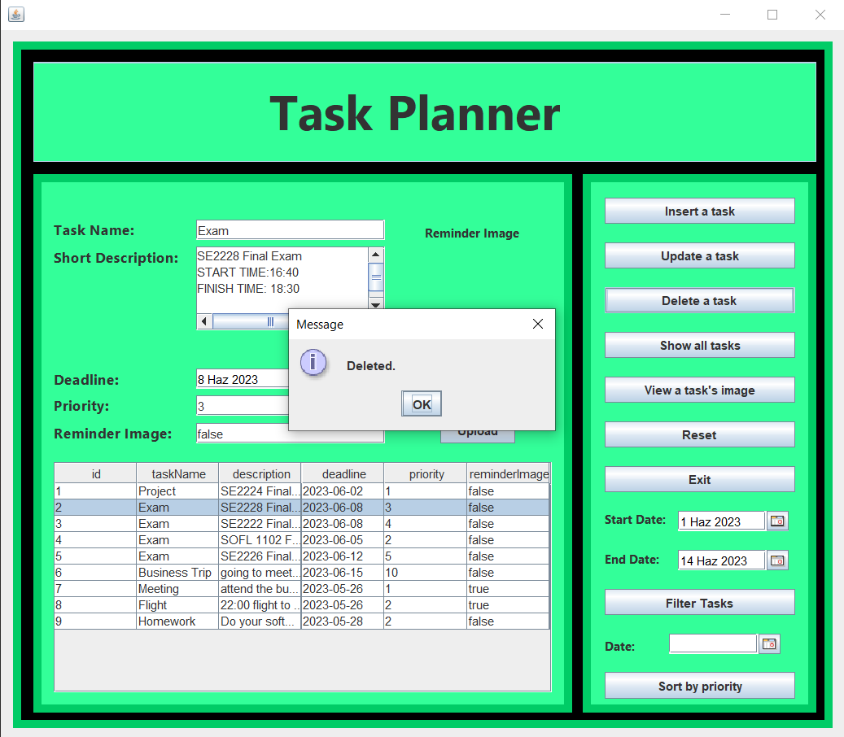
DELETE A TASK

Slide 11
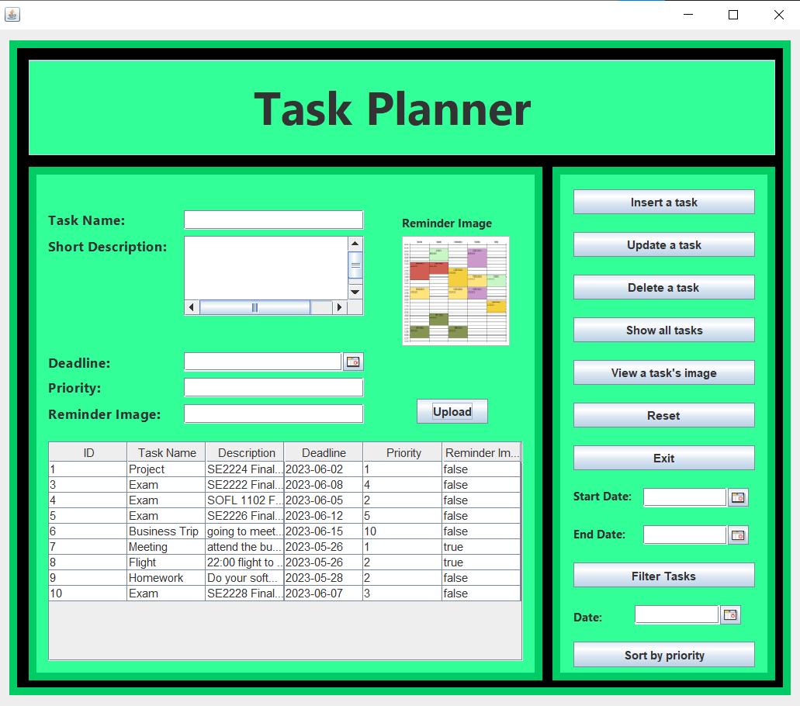
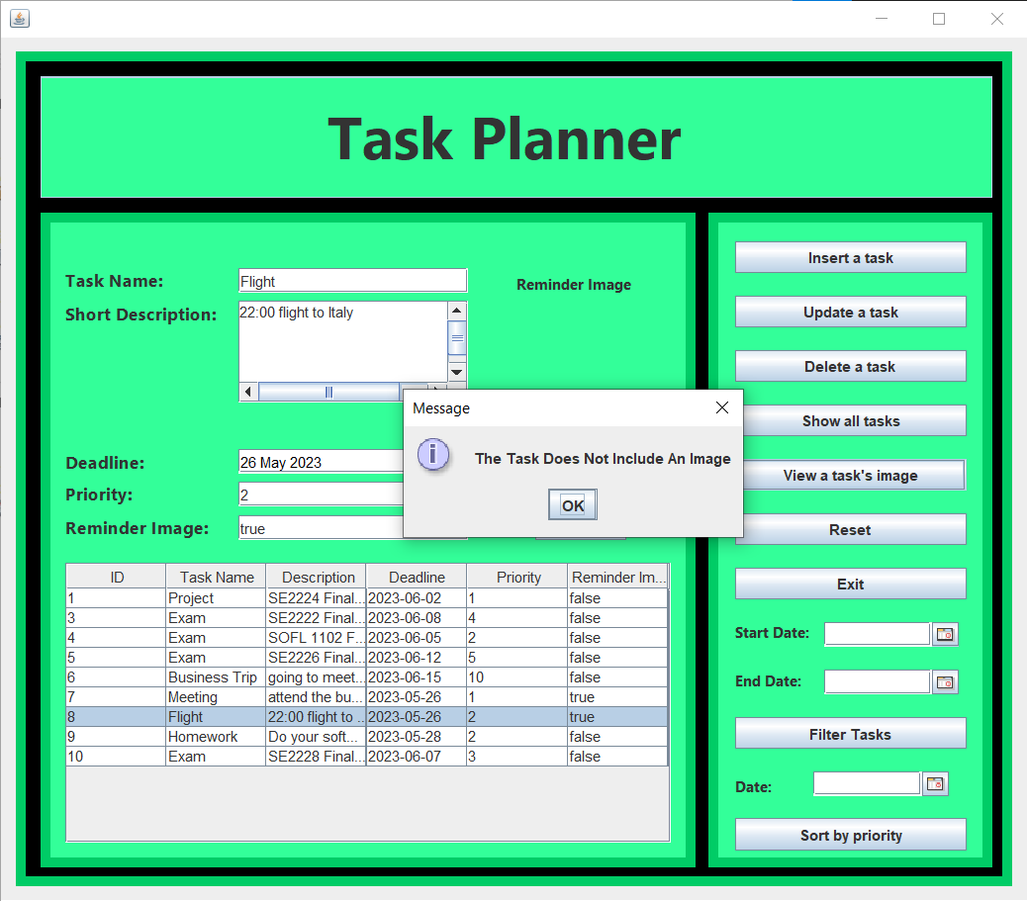
IMAGE

Slide 12

THANK YOU FOR LISTENING TO ME.

